Slide 1
The (new) Digital System for the environmental planning law in The Netherlands
Using machine readable texts and decision logic
Presentation: Vincent van Dijk
9 June 2021

Slide 2
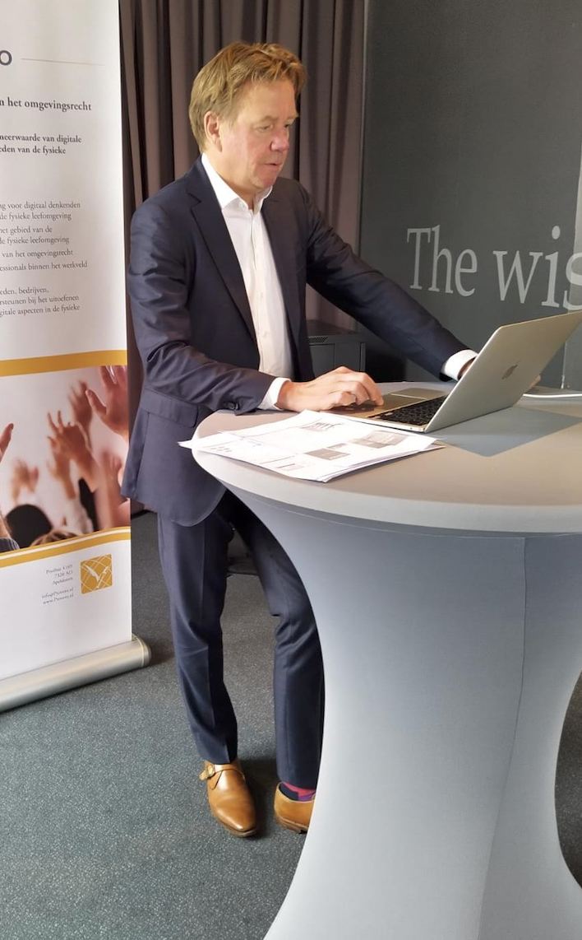
Introduction
Notes:
Vincent is a senior advisor on rule driven solutions and has almost 20 years of experience in the triangle composed of rules, processes and data. His legal background and extensive experience with IT projects help Vincent to understand both the business domain and implementation aspects in organisations with complex rules or information architecture.
In the context of DSO, he has the role of product owner for the business rules management solution
Rijkswaterstaat is one of the development partners. It is a Dutch governmental organization, part of the Ministry of Infrastructure and Water Management.

Slide 3
Programme
Introduction
Goals of the (new) Dutch environmental planning law
High level overview of the smart digital solution
Standardization: three new standards to support the solution
Official publications
Decision rules
Permit application
Use of machine readable legal texts
Connecting legal rules and decision rules
Q & A
Notes:
Not so Future state, we are doing parts allready

Slide 4
Omgevingswet
Goals of the (new) Dutch environmental planning law

Slide 5
A new environmental planning law
Environmental legislation now consists of 26 laws and 135 further regulations for land use, residential areas, infrastructure, the environment, nature and water.
Each has its own starting points, procedures and requirements.
This makes the legislation too complex for the people who have to work with it. Consequently, it takes longer to get projects off the ground.
Through the Environment and Planning Act (Omgevingswet) the government wants to combine and simplify the regulations for spatial projects in 1 law and 5 further regulations.

Slide 6
A new environmental planning law
Environmental Plan for authorities
A single environmental plan for the entire area will replace current local regulations. This means fewer regulations and more cohesion. Decisions can be made quicker.
From “no, unless” to “yes, if …”
A change in culture will change the situation that plans are received with a taste of “no”. This will change to a more benevolent regime.
There will be more space for made to measure solutions.
‘One-stop-shop’ for citizens and companies
Only one authority will make the decision. This simplifies things for the applicant and speeds up the permit application procedure.
Supported by a new digital system, with special focus on a rule management solution to support a quicker change process and direct control over content.
More information: https://www.government.nl/topics/spatial-planning-and-infrastructure/revision-of-environment-planning-laws

Slide 7
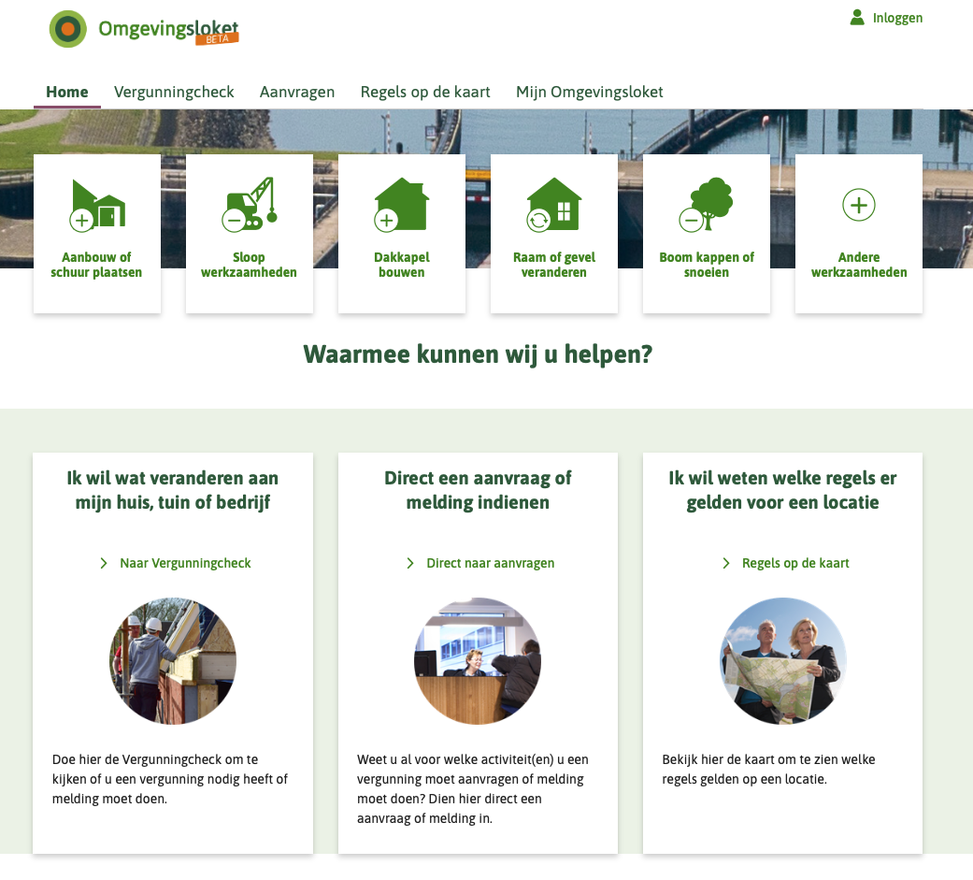
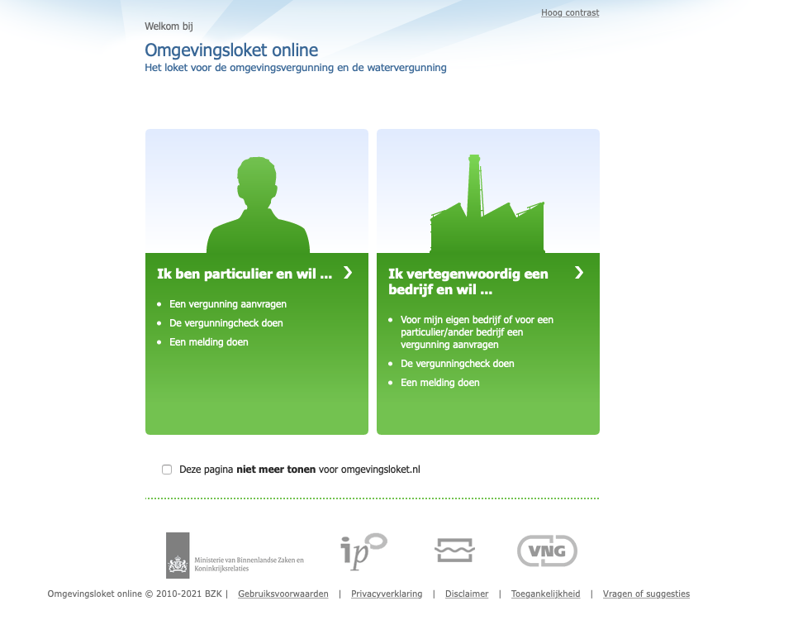
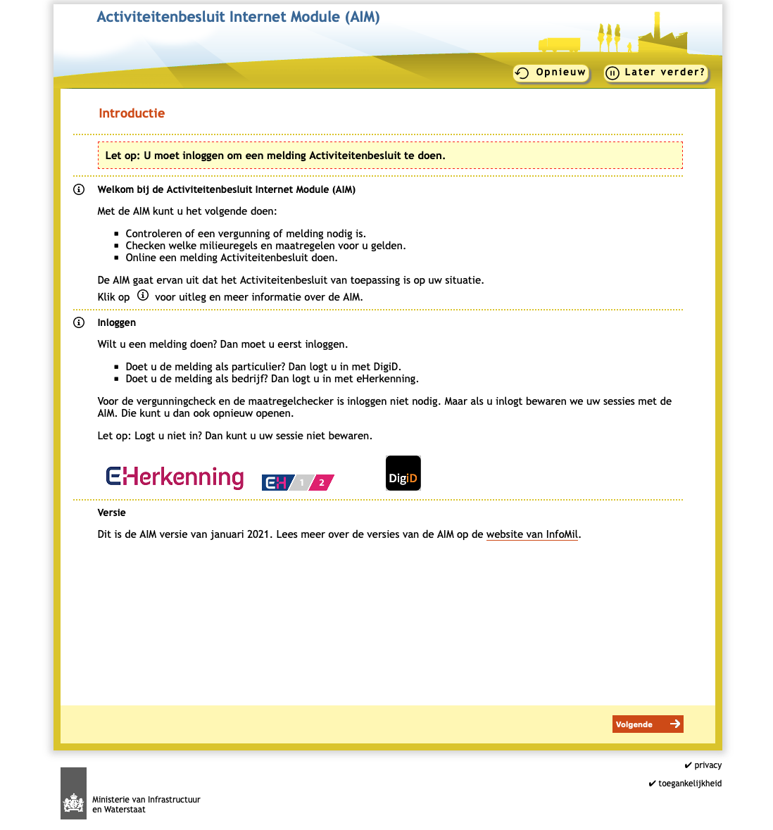
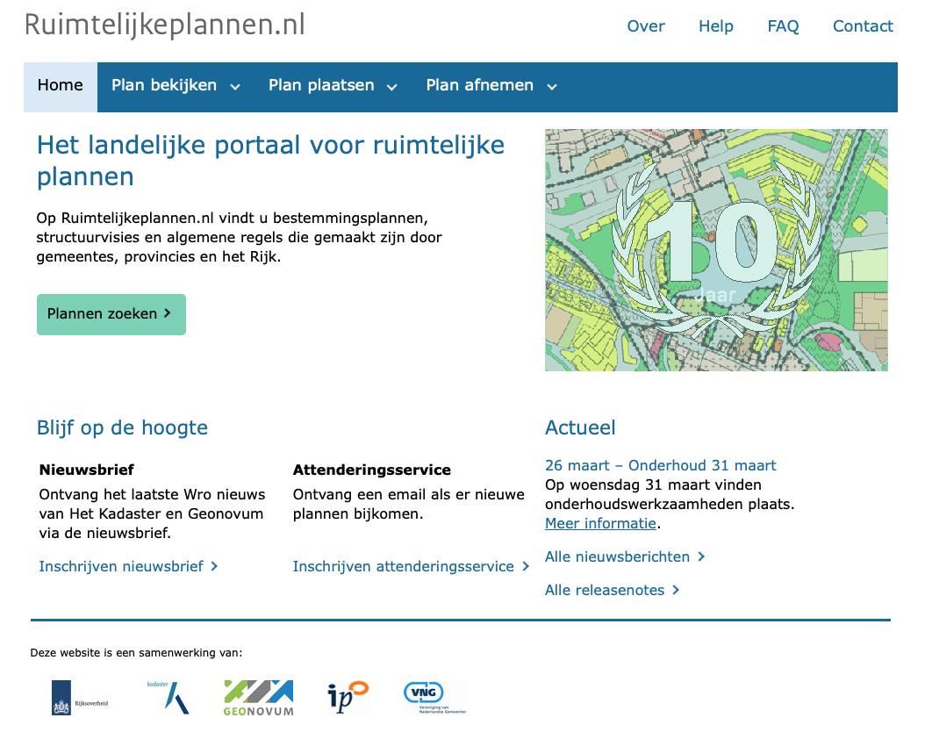
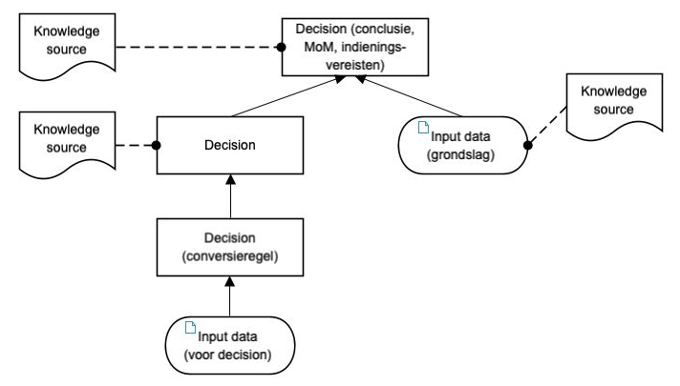
A new digital system
SECTION 20.5 DIGITAL SYSTEM OF INFORMATION PROVISION
Article 20.20 (digital system)
There is a digital system of information provision about the physical living environment.
Notes:
A better Information provision is the main goal of the digital system
Current system is not coherent; stand alone applcations
One portal, steered by machine readable text and decision rules
DEMO, GBT laten zien: https://pre.omgevingswet.overheid.nl/home

Slide 8
The Digital System
High level overview of the smart digital solution

Slide 9
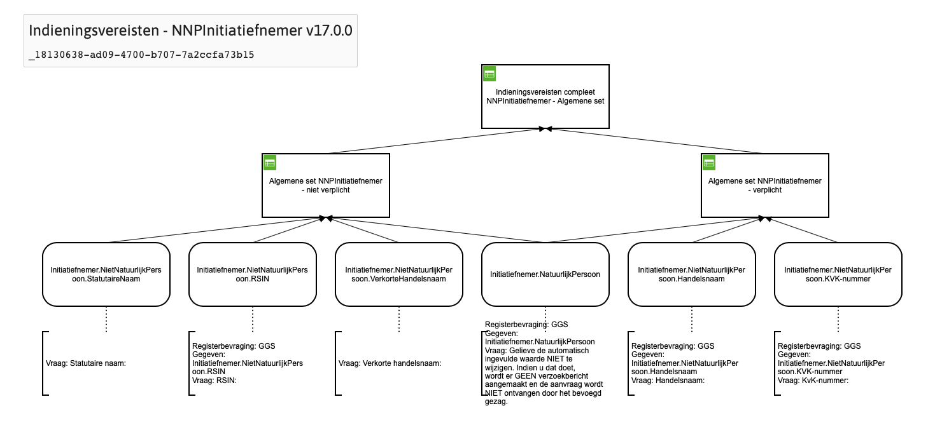
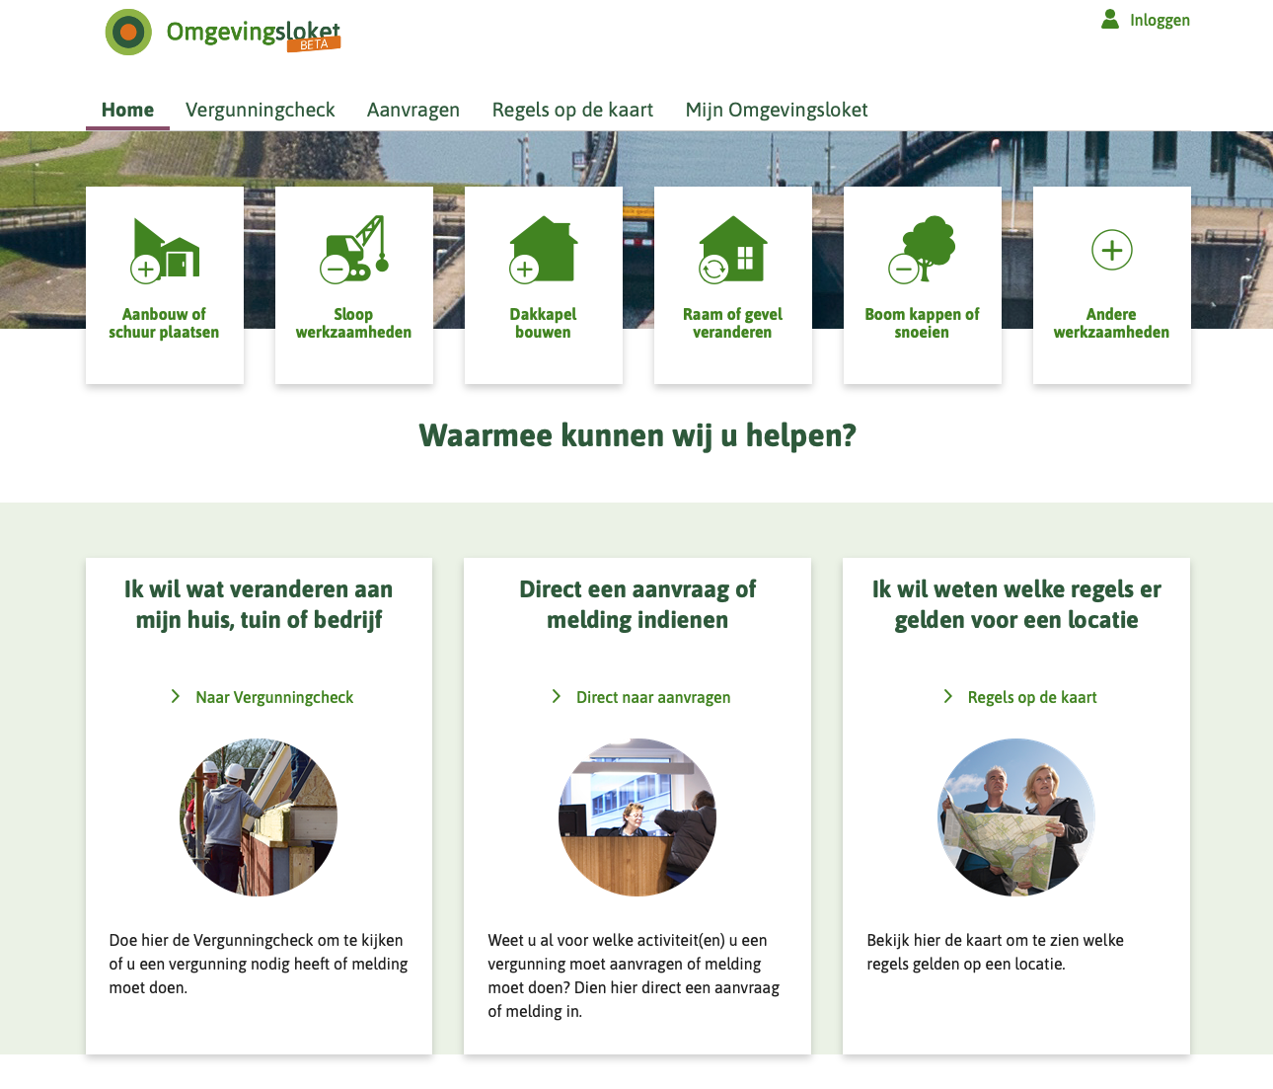
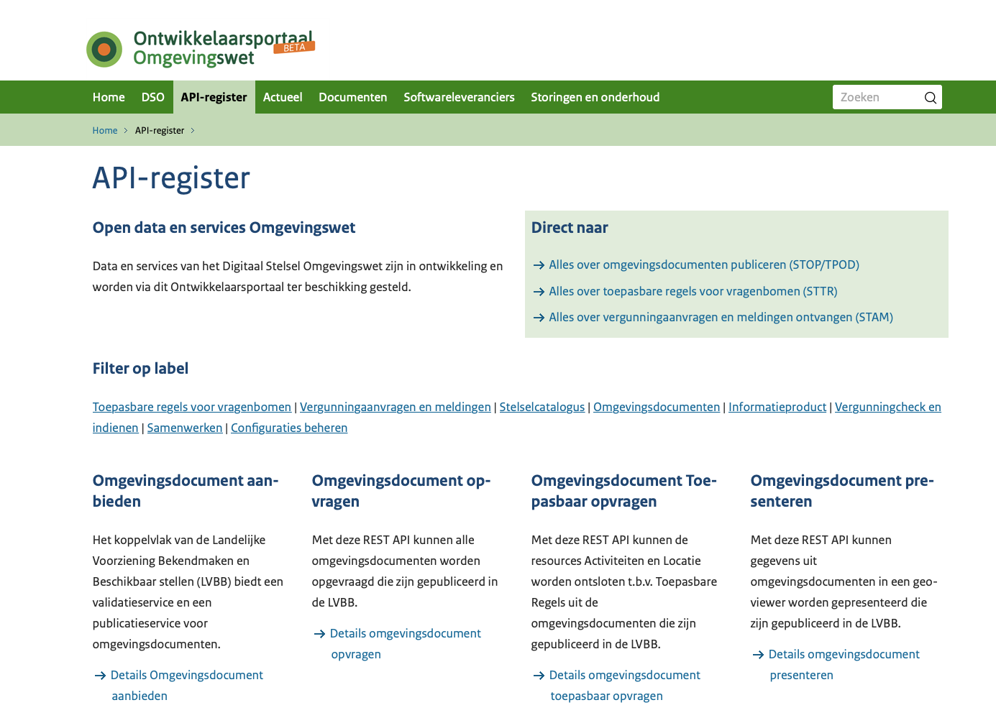
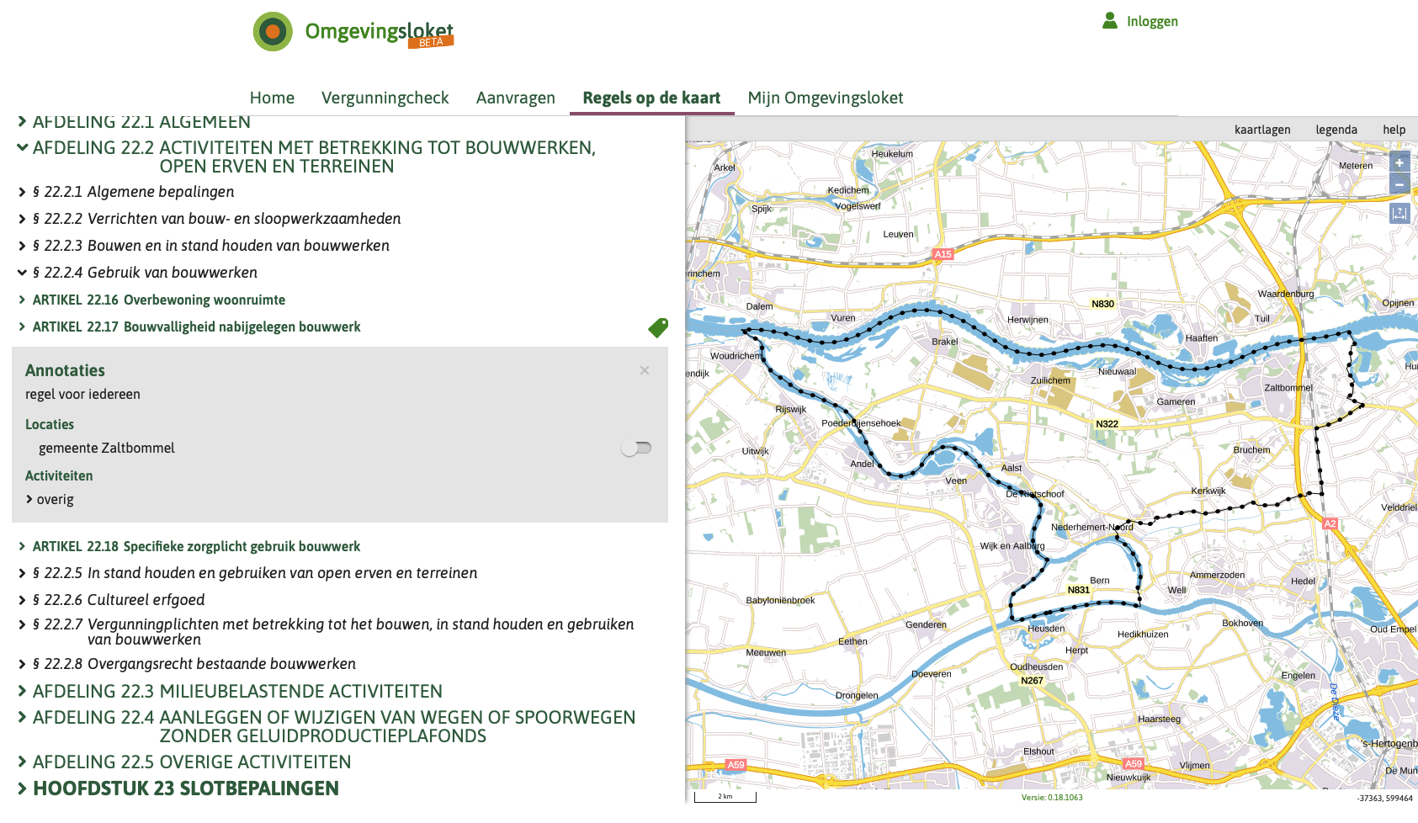
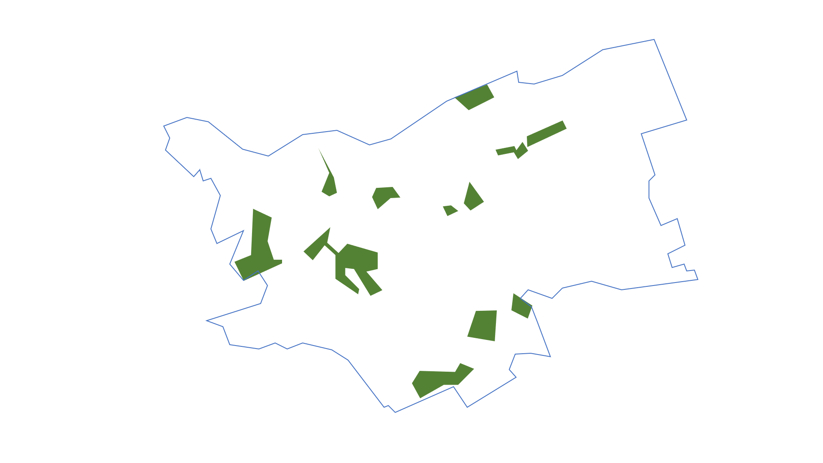
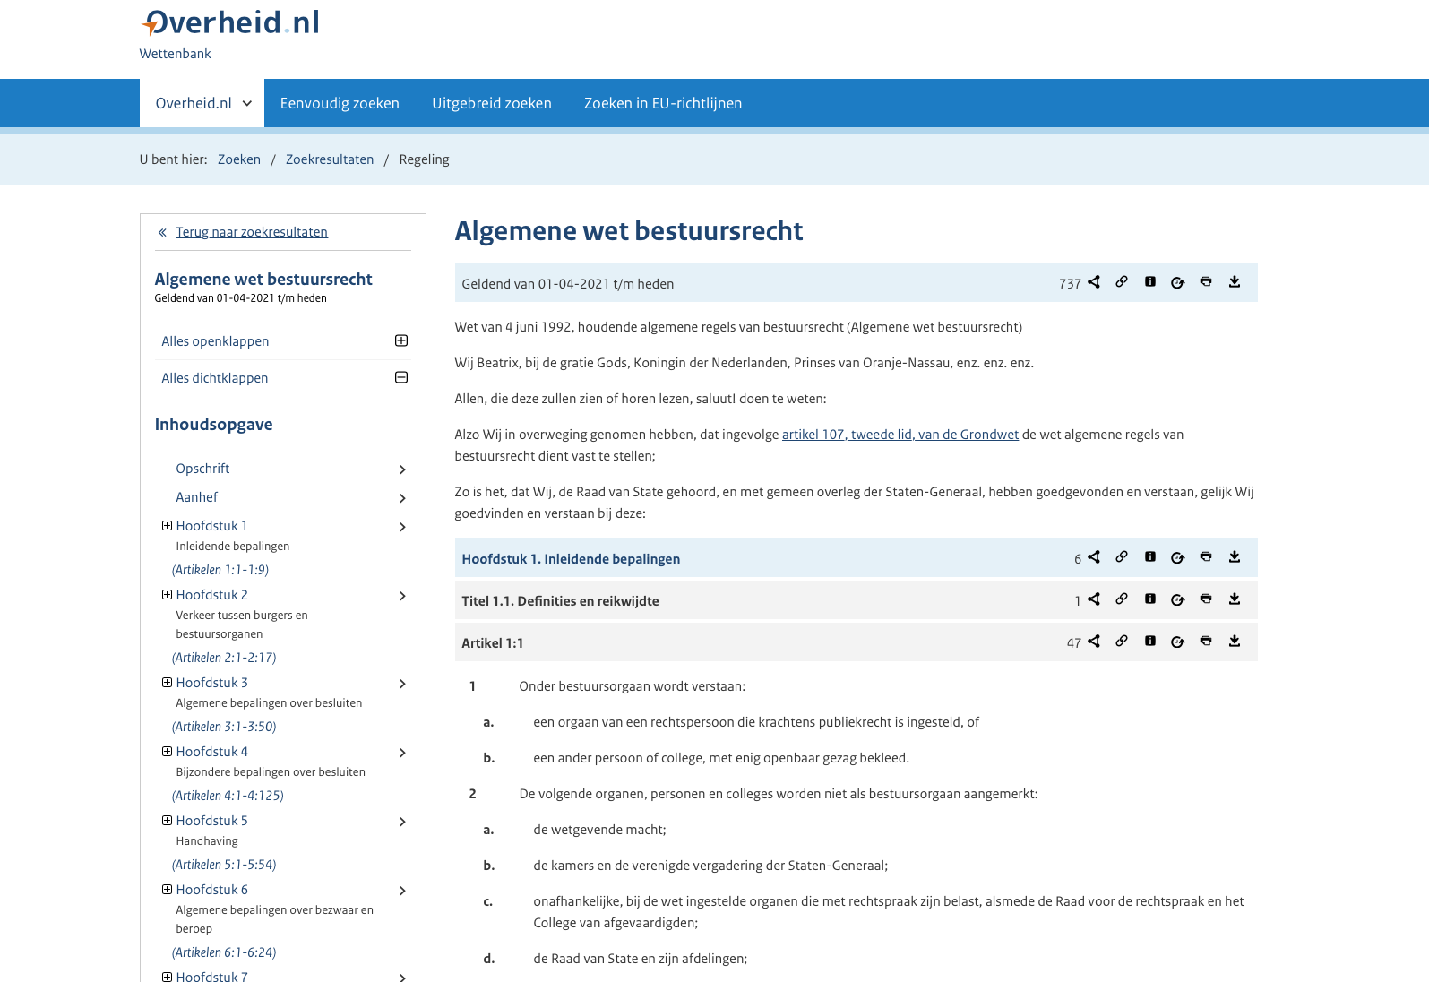
Overview of the smart digital solution
Rule engine and rule repository
Interface for decision rules based on standard
Local systems
Permit check
Permit application
Interface for applications based on standard
Official registrations
Cen-tral hub
Legal document viewer
Open system
Central catalogue
E-Government building blocks
Central repository
SOA
Interface for legal documents and objects based on standard
SOA
Official publications and notifications
Notes:
Looks complicated, and in Dutch
Ok, it is complicated
I will highlight the important components
Local systems: law making, rule governance, applications
E-government building blocks: registration systems (COR), geometry of governments, auditing, etc.

Slide 10
Demonstration: permit check
Notes:
Goal: to show how all the components work together
Aanbouw, uitbouw of bijgebouw bouwen of vervangen
Oppervlakte gebruiken voor de toelichting
Heeft het nieuwe bouwwerk een dak? : ja (of nee)
Bij een woning: ja
Ten dienste van wonen
Woning blijft gelijk
Geen monument
Geen archeologie
Verdiept in de grond
En direct door naar aanvragen

Slide 11
Demonstration: permit check
Completely rule driven: check and application
Conclusion based on legal grounds derived by facts
Use of legal objects from legal documents
Specified by law makers and decision rules specialists
Notes:
Goal: to show how all the comonents work together
Aanbouw, uitbouw of bijgebouw bouwen of vervangen
Oppervlakte gebruiken voor de toelichting
Heeft het nieuwe bouwwerk een dak? : ja (of nee)
Bij een woning: ja
Ten dienste van wonen
Woning blijft gelijk
Geen monument
Geen archeologie
Verdiept in de grond
En direct door naar aanvragen

Slide 12
Standardization
Three new standards to support the solution
Notes:
A deeper dive into the standards

Slide 13
Overview of the smart digital solution
Rule engine and BR repository
Standard
Interface for business rules based on standard
Local systems
Permit check Permit application
Interface for applications based on standard
Official registrations
Standard
Cen-tral hub
Legal document viewer
Open system
Central catalogue
E-Government building blocks
Central repository
SOA
Interface for legal documents and objects based on standard
SOA
Standard
Official publications and notifications
Notes:
Looks complicated, and in Dutch
Ok, it is complicated
I will highlight the important components
Local systems: law making, rule governance, applications
E-government building blocks: registration systems, geometry of governments

Slide 14
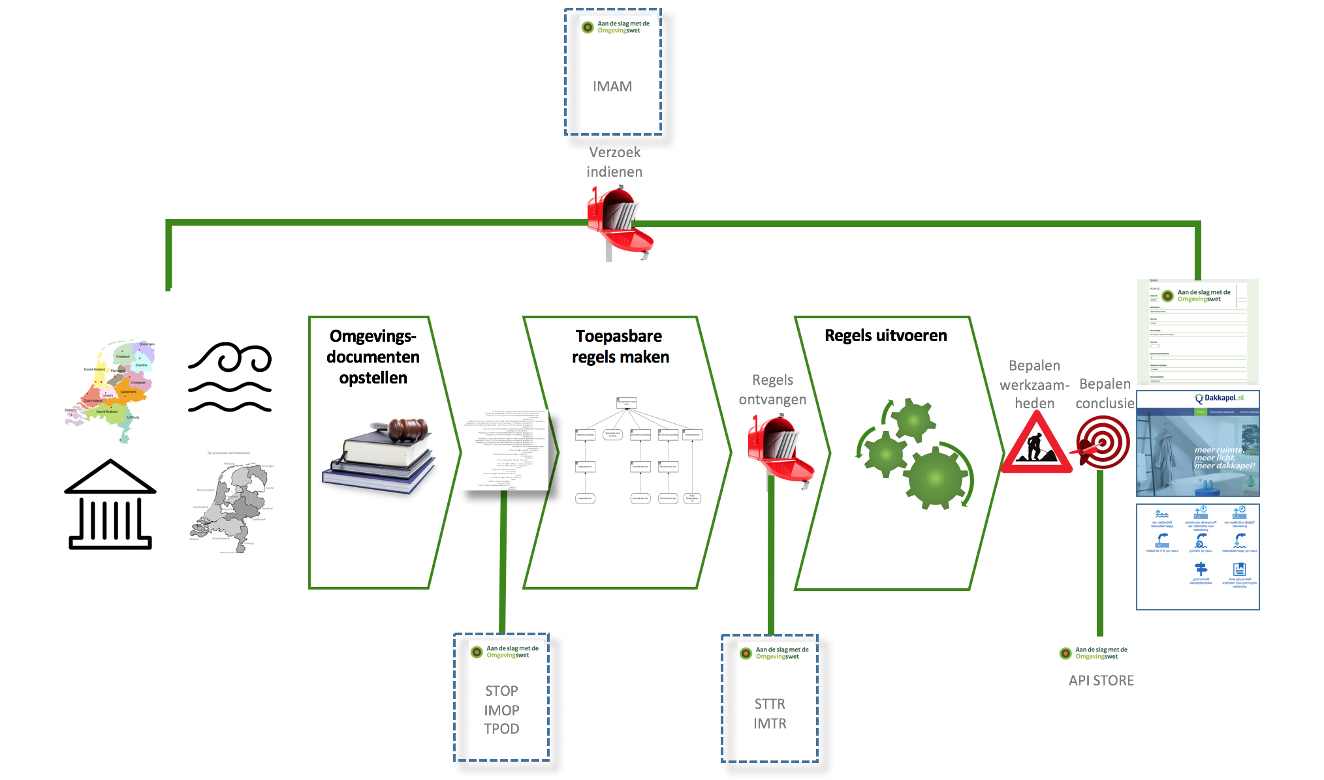
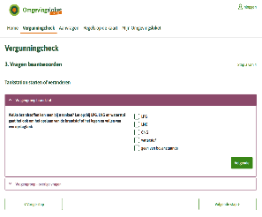
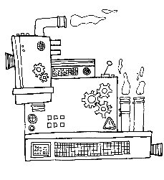
Standardization
“From law to customer portal”
STAM
Law
making & publication
Decision management
Rule execution
Central government
12 provinces
21 water authorities
347 municipalities
Notes:
Het proces hier toelichten: van wet naar loket in samenhang met de verschillende standaarden

Slide 15
Standardization
Three new standards to support the solution: STOP
Notes:
A deeper dive into the standards

Slide 16
STOP
The Standard Official Government Publications, abbreviated STOP, supports the drafting, enactment, publishing and making available of official government publications through the digital system.
Not just text, but text enriched with information needed by the digital system (“machine readable documents”):
To show on a map what the rules are
To give information on a map what is (not) allowed
To use information in rule execution directly from source

Slide 17
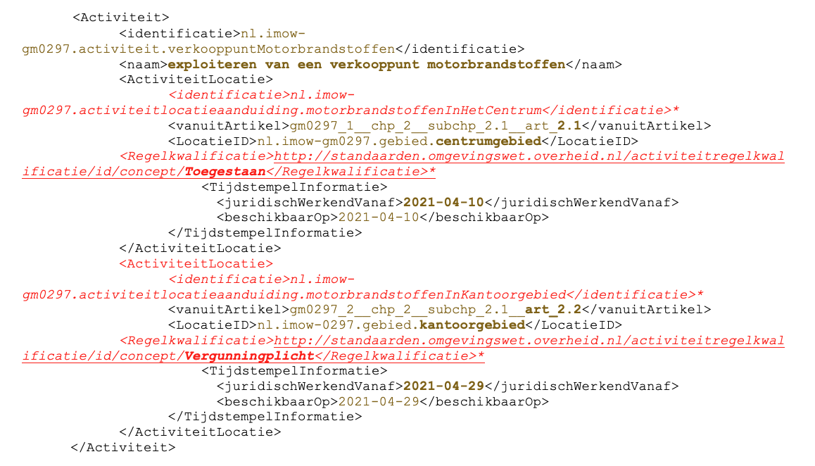
What is a machine readable document?
Document viewer and Rule engine
Use information added to text
Central repository
Document
Text has a machine readable meaning
Object
Object
Object
Add information to tekst (“annotation”)
Official publications and notifications
Notes:
Machine readable texts
Objects available for other processes to support information provision
This is a very high level overview and some simplification had been added.

Slide 18
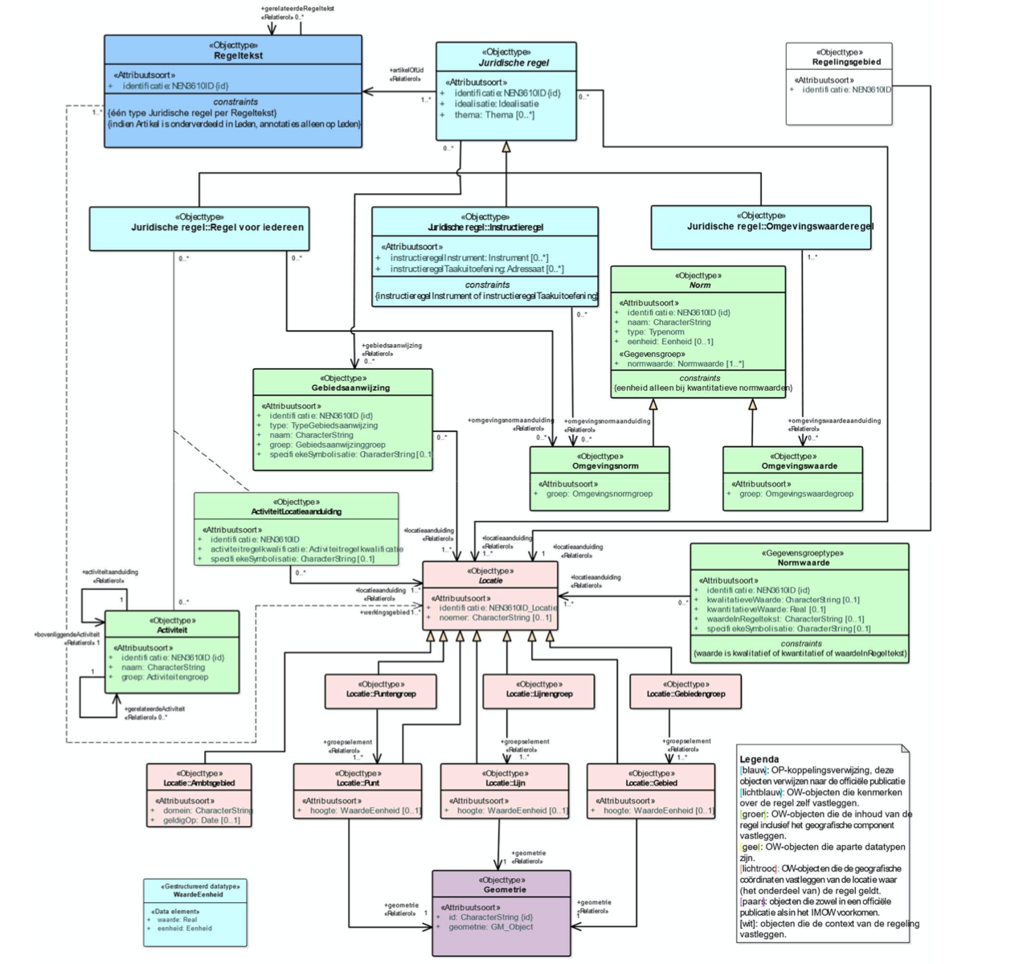
Information model (IM-OW)
Notes:
Elaborate on interesting objects
Legal tekst
Objects: activity, location, legal sources, legal norms/values (future)
Rule qualification
What are the rules, for my activity on my location? What is allowed?
Only relevant rules on applicant’s location

Slide 19
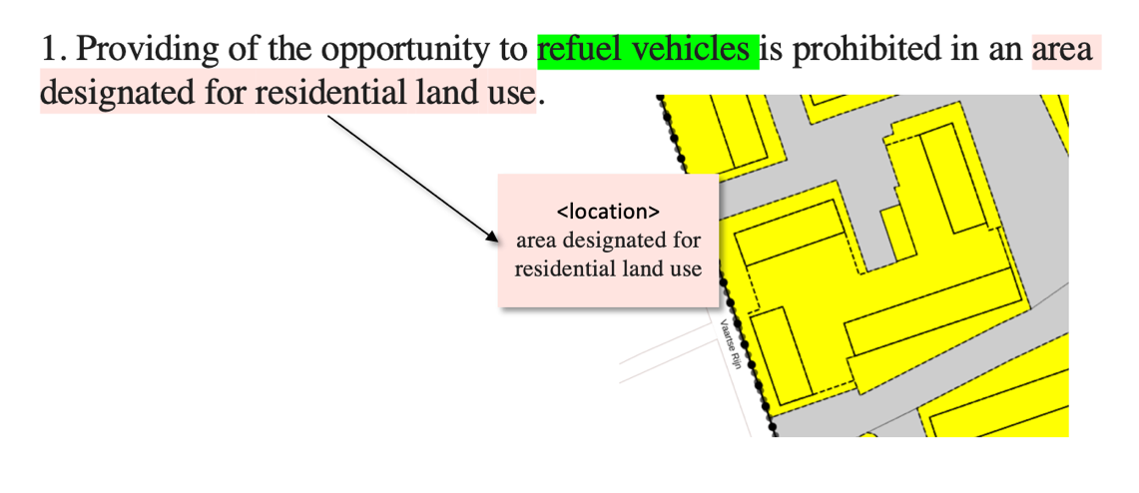
Examples

Slide 20
Standardization
Three new standards to support the solution: STTR
Notes:
A deeper dive into the standards

Slide 21
STTR
In order to be able to do a permit check or to apply for a permit,
the competent authorities translate their legal rules into decision rules.
These decision rules are understandable translations of legal rules.
The agreements are laid down in the Standard on decision rules. (STTR) and the associated information model (IMTR).
Based on the Decision Model and Notation (DMN) standard by OMG.
STTR/IMTR describe the semantics and syntax needed for nearly 400 authorities as the source of decision rules.
Notes:
Why business rules? They have another perspective compared to legal rules.
Legal structure of articles and tekst vs actvity/goal driven perspective of applicant

Slide 22
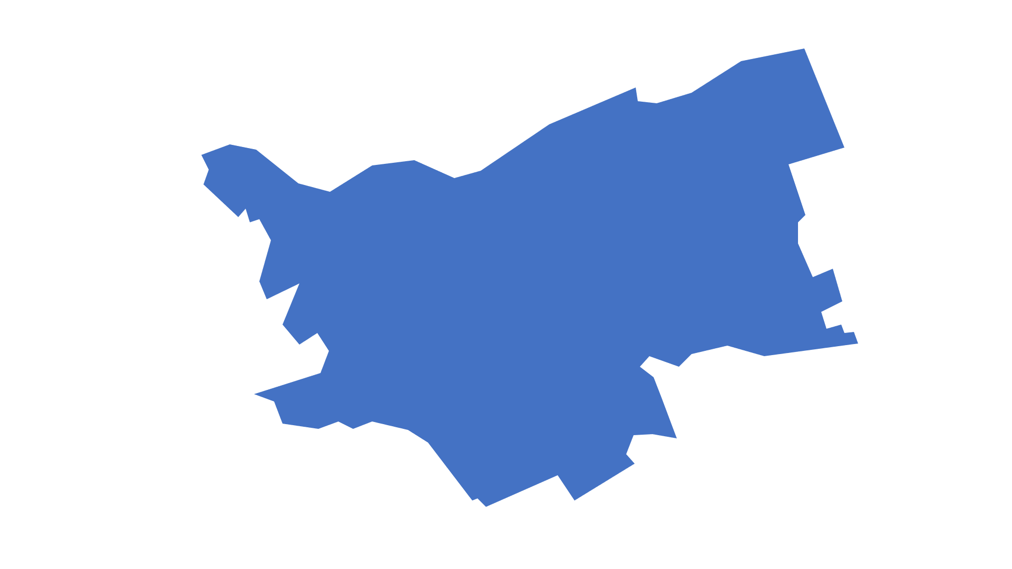
Stacking rules
Local community
Water board
Province
Central government
Notes:
Rules from different authorities may be applicable and have to workt together in the portal

Slide 23
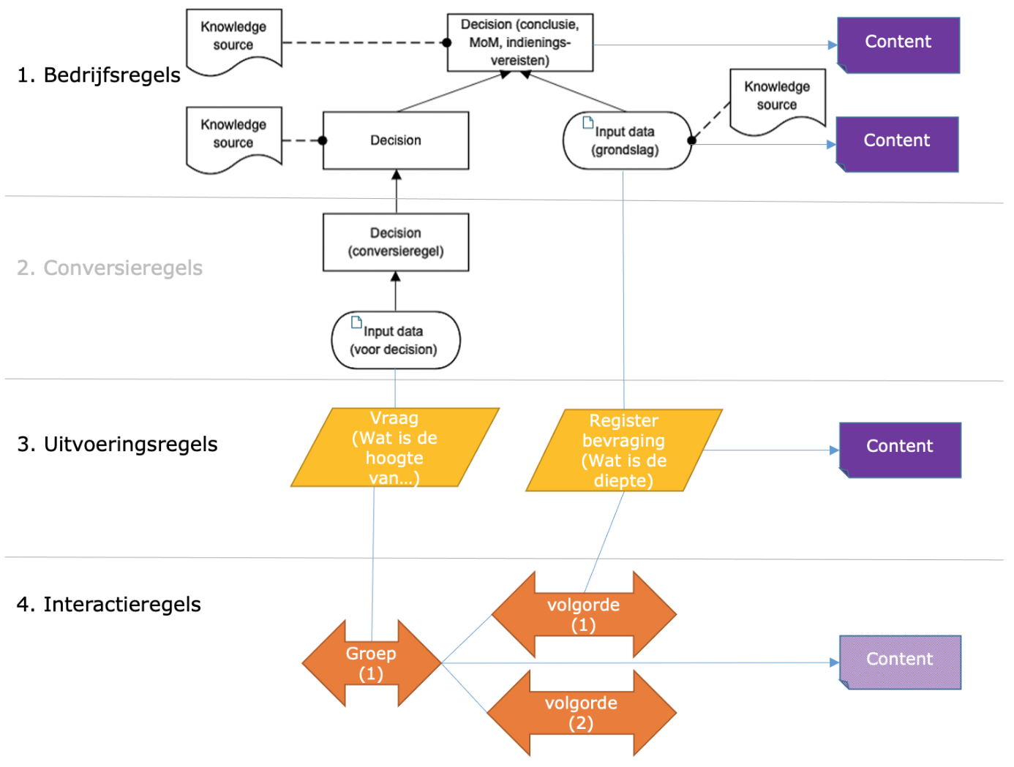
Standaard Toepasbare Regels (STTR)
1. Decision rules
2. Conversion rules
3. Data rules
4. Interaction rules

Slide 24
Why DMN as the core of STTR?
DMN decision rules can be understood and used by a rule engine (full DMN!)
No transformation needed from ”business rules” to “execution rules”
DMN Decision logic can be read by legal experts
Traceability between legal sources and decision rules
DMN can be extended using extension elements

Slide 25
Using the standards
Connecting legal rules and decision rules (demo)
Notes:
A deeper dive into the standards

Slide 26
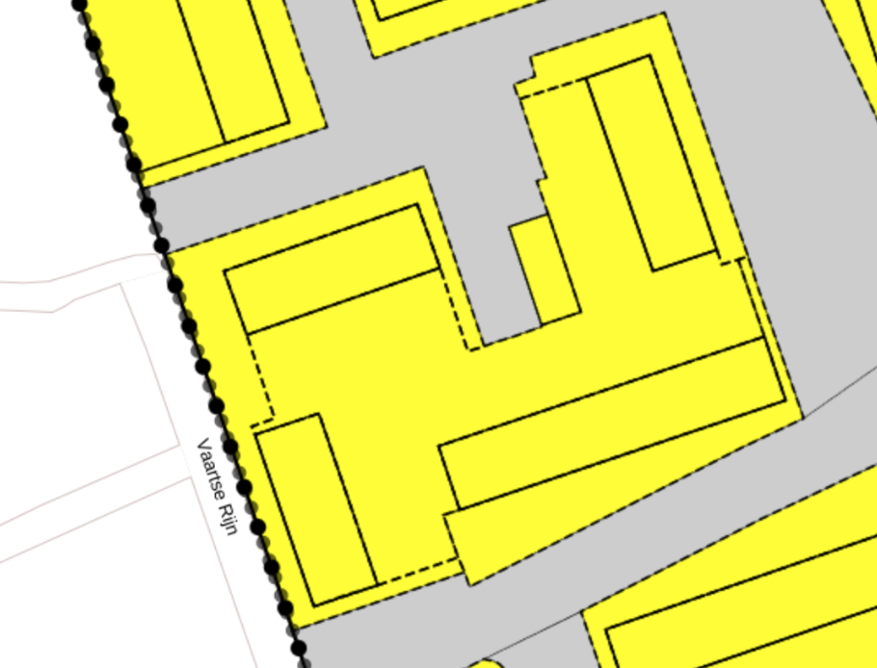
Connecting legal rules and business rules
Providing of the opportunity to refuel vehicles is prohibited in an area designated for residential land use“
Decision rules
<activity>
Refuel vehicles
<decision >
Prohibited
<Input data>
location
<data rule>
Objects
<location>
Area for residential land use
Notes:
Some explanation

Slide 27
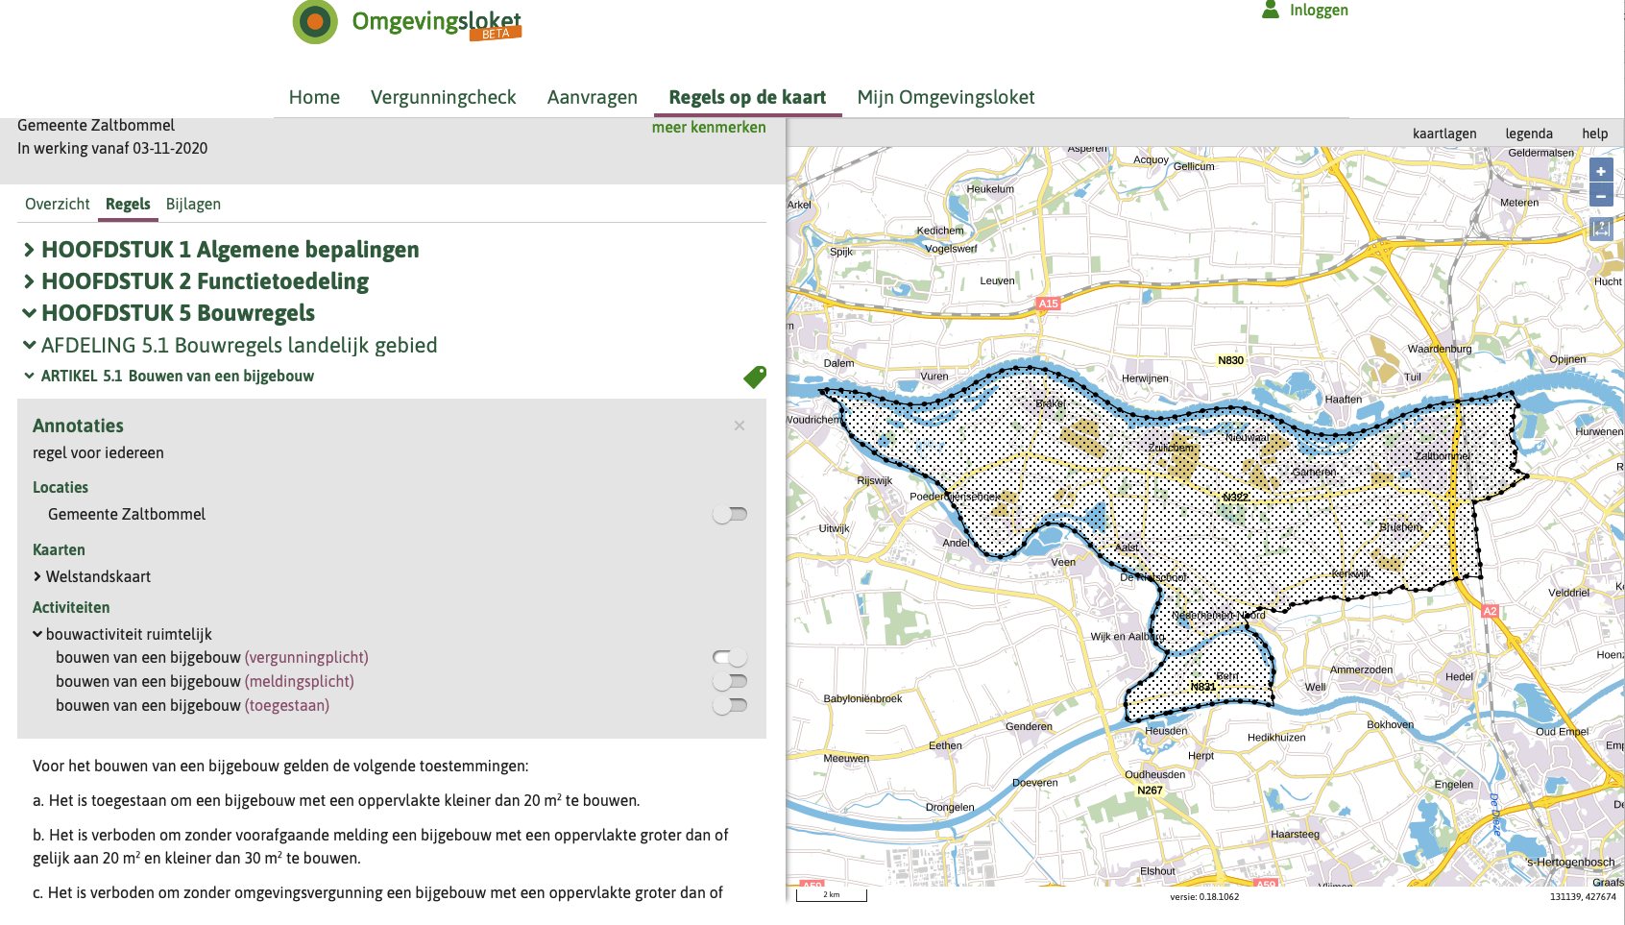
Notes:
The main presentation
Demo: RTR
Activity structure
Decision rules for every activity and supported actions on an activity
Regels over bouwen van een bijgebouw tonen op de Viewer (https://acceptatie.viewer.dso.kadaster.nl/document/%2Fakn%2Fnl%2Fact%2Fgm0297%2F2019%2Freg456RGL-20210527-172014/regels)
https://acc.omgevingswet.overheid.nl/registratie-toepasbare-regels/id/nl.imow-gm0297.activiteit.2019000800
Demo doen op ACC: 1) locatie laten zien, 2) regels laten zien, waarbij conclusie anders wordt
Demo op RTR: DRD and decision table
Groter voorbeeld: https://pre.omgevingswet.overheid.nl/registratie-toepasbare-regels/id/IndieningsvereistenVergunningnl.imow-ws0665.activiteit.GravenBodemWaterbodemOppw

Slide 28
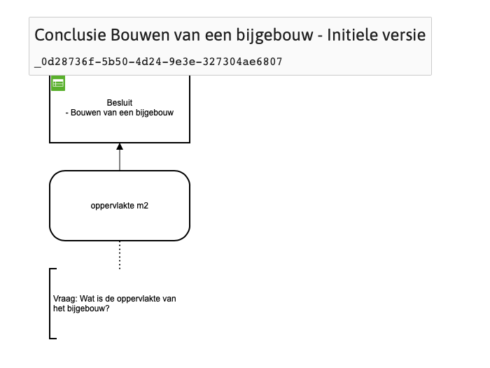
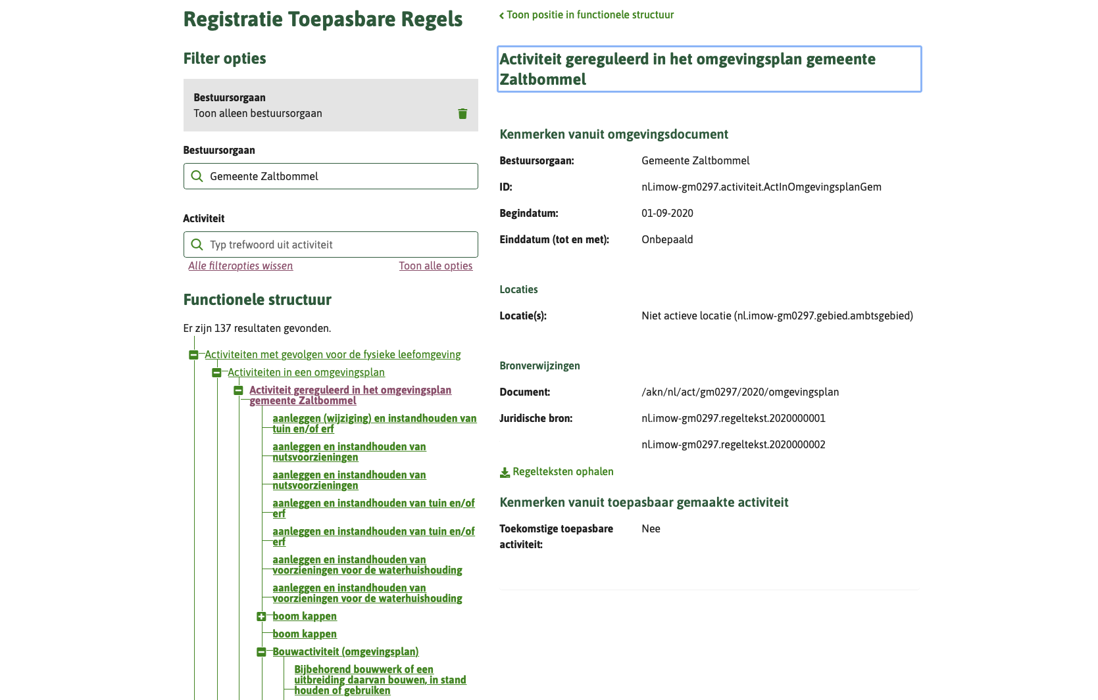
Demonstration
Notes:
Backup als omgeving down is
Groter voorbeeld: https://pre.omgevingswet.overheid.nl/registratie-toepasbare-regels/id/IndieningsvereistenVergunningnl.imow-ws0665.activiteit.GravenBodemWaterbodemOppw

Slide 29
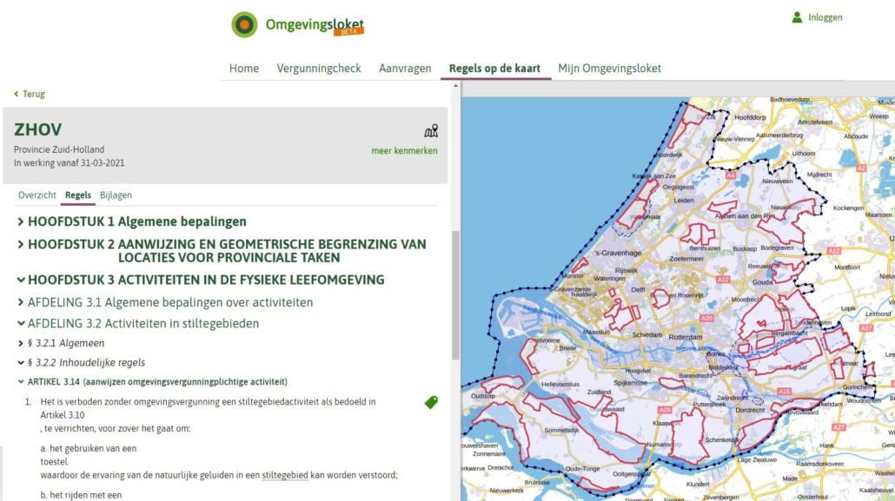
Notes:
Further examples, if time allows
/akn/nl/act/gm0014/2021/reg014

Slide 30
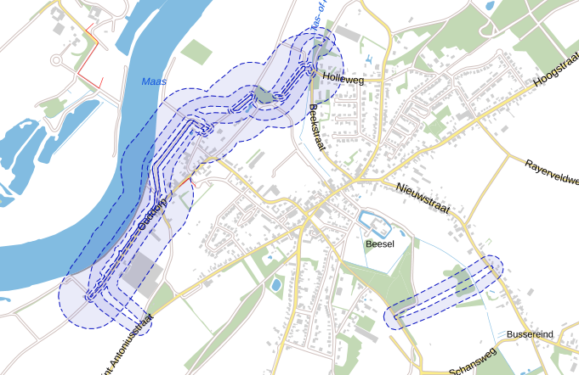

Slide 31
Future developments
More integration of external registrations in decision and data rules (e.g. Monuments)
Re-use of decision logic between authorities
Further use of objects:
Norms and values (e.g. maximum building height)
Rule qualification
…

Slide 32
Standardization
three new standards to support the solution: STAM
Notes:
A deeper dive into the standards

Slide 33
Standardization
“From law to customer portal back to governing body”
STAM
Law
making & publication
Decision management
Rule execution
Notes:
Depending on time

Slide 34
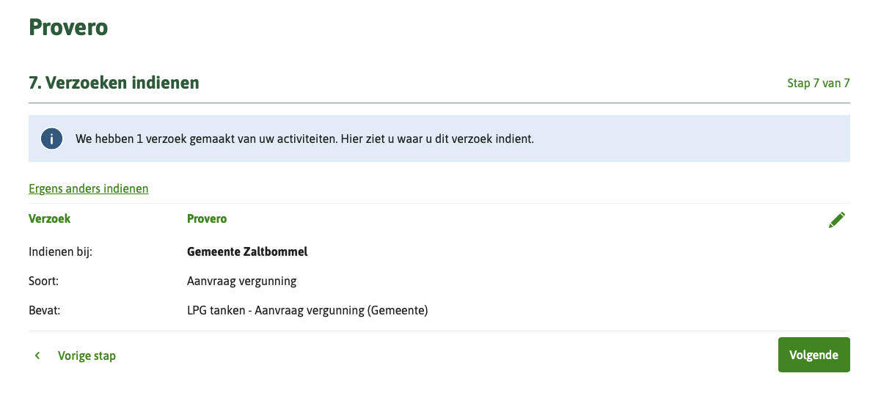
Application submitted
Document
Activity
Notes:
Demo in het loket – PRE : zaltbommel : LPG tanken

Slide 35
Q & A

