Slide 1
RULES AS CODE
DIGDIR
@OPSIgov
#RulesAsCode

Slide 2
JAMIE BERRYHILL
Innovation specialist
@jamie_berryhill
DIGDIR 2021
#RulesAsCode

Slide 3
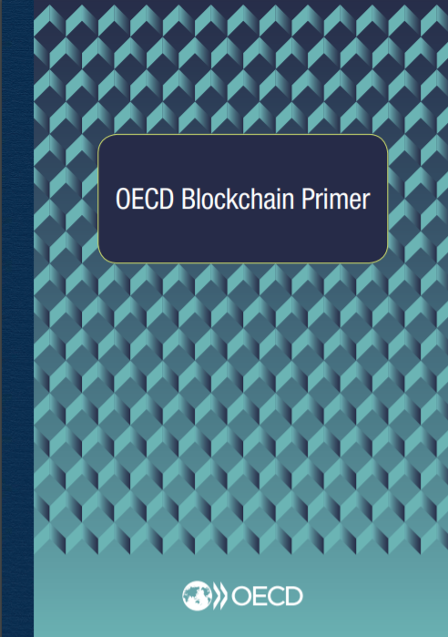
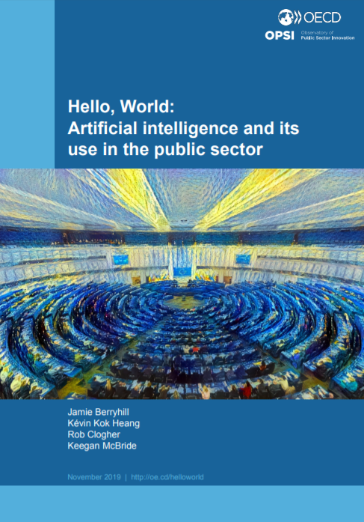
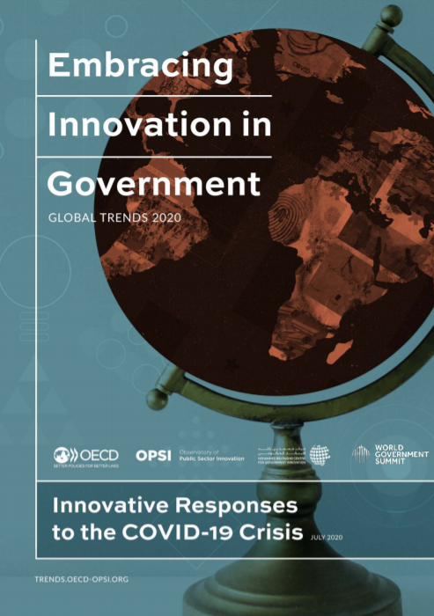
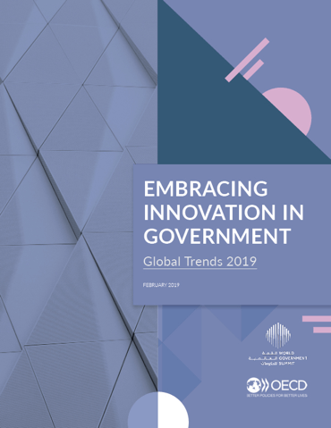
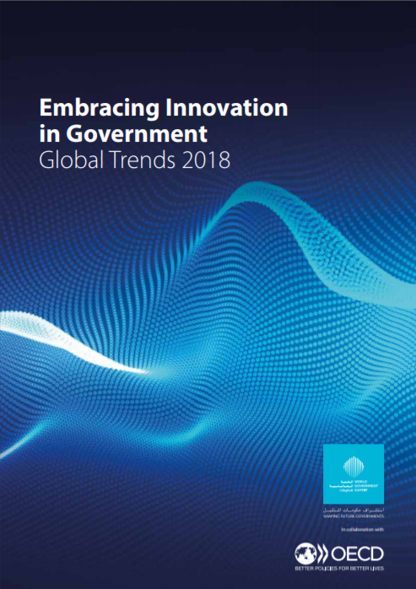
OPSI MISSION
UNCOVERING
WHAT IS NEXT

Slide 4
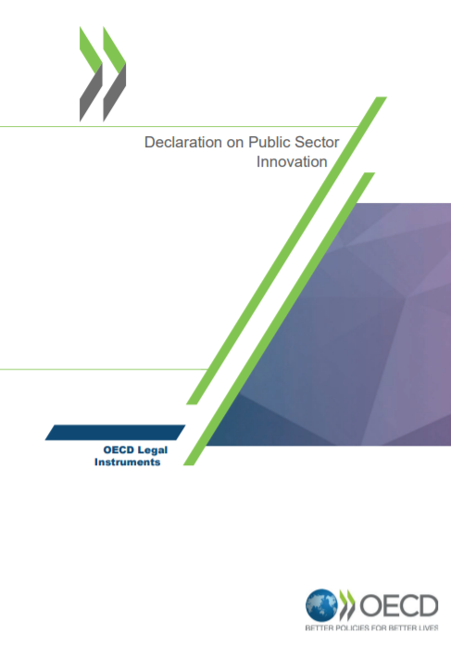
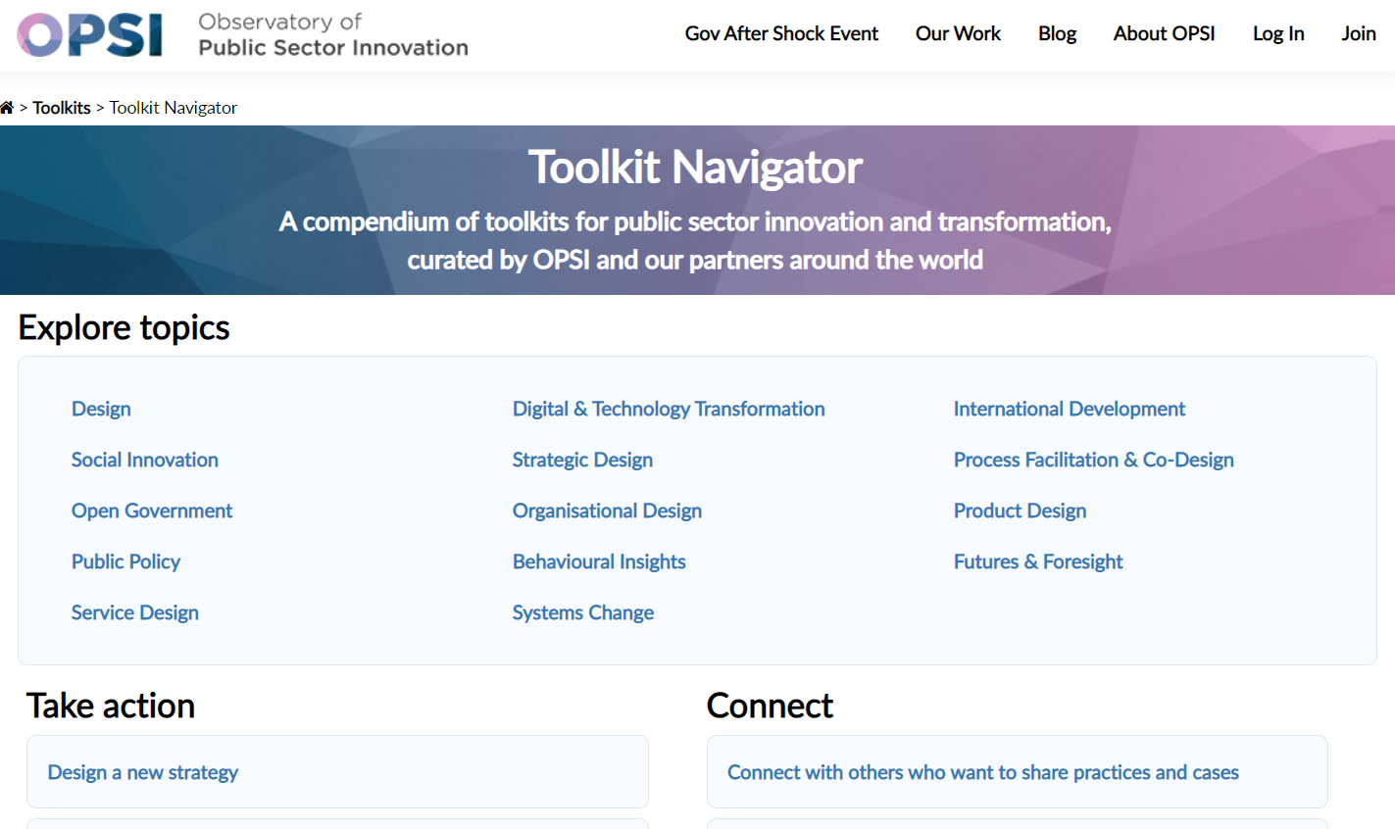
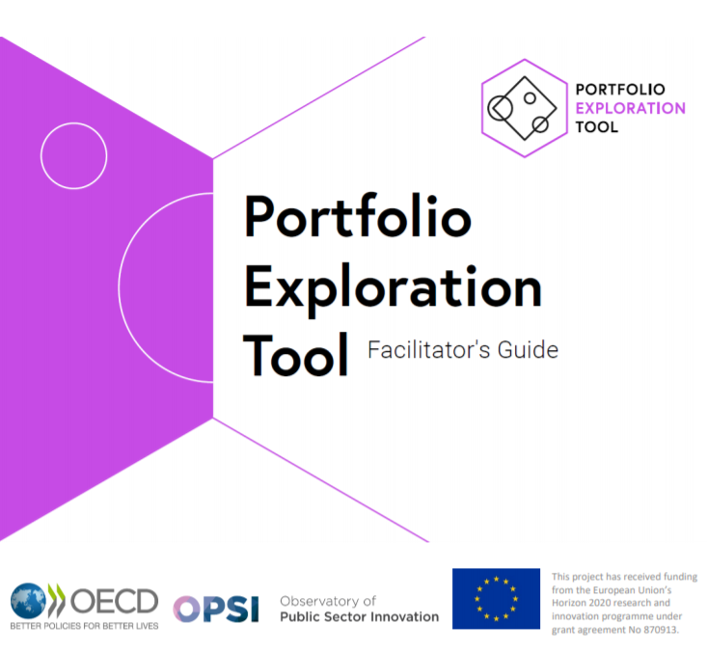
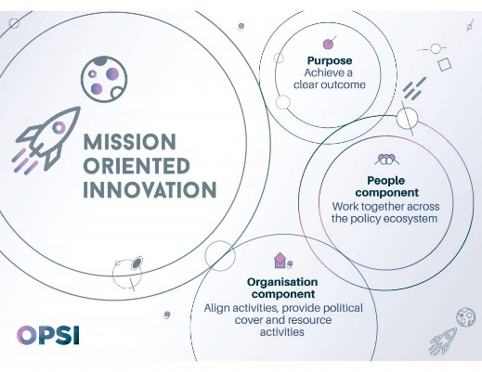
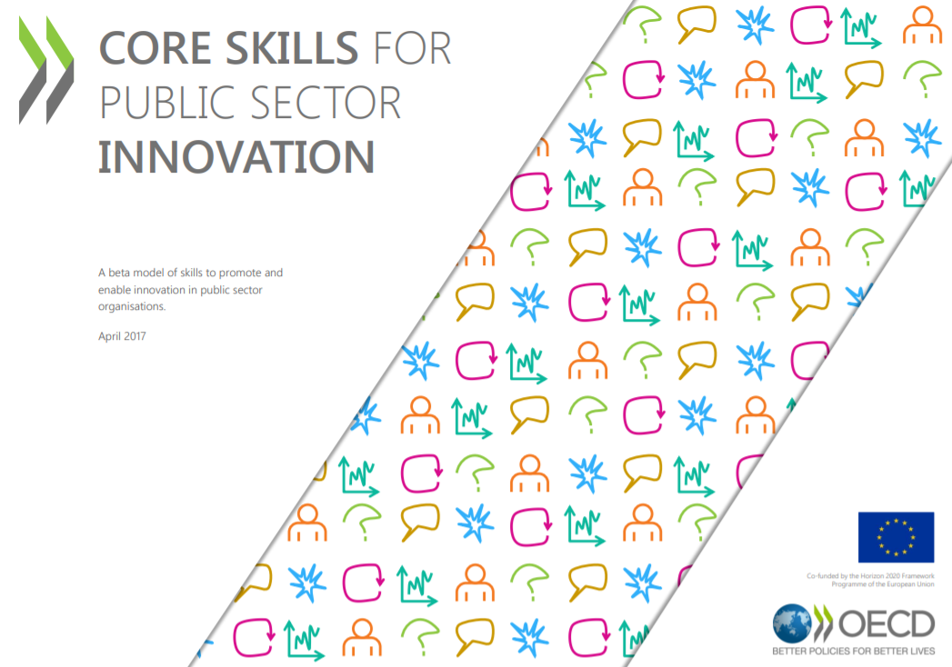
OPSI MISSION
TURNING THE NEW INTO NORMAL

Slide 5
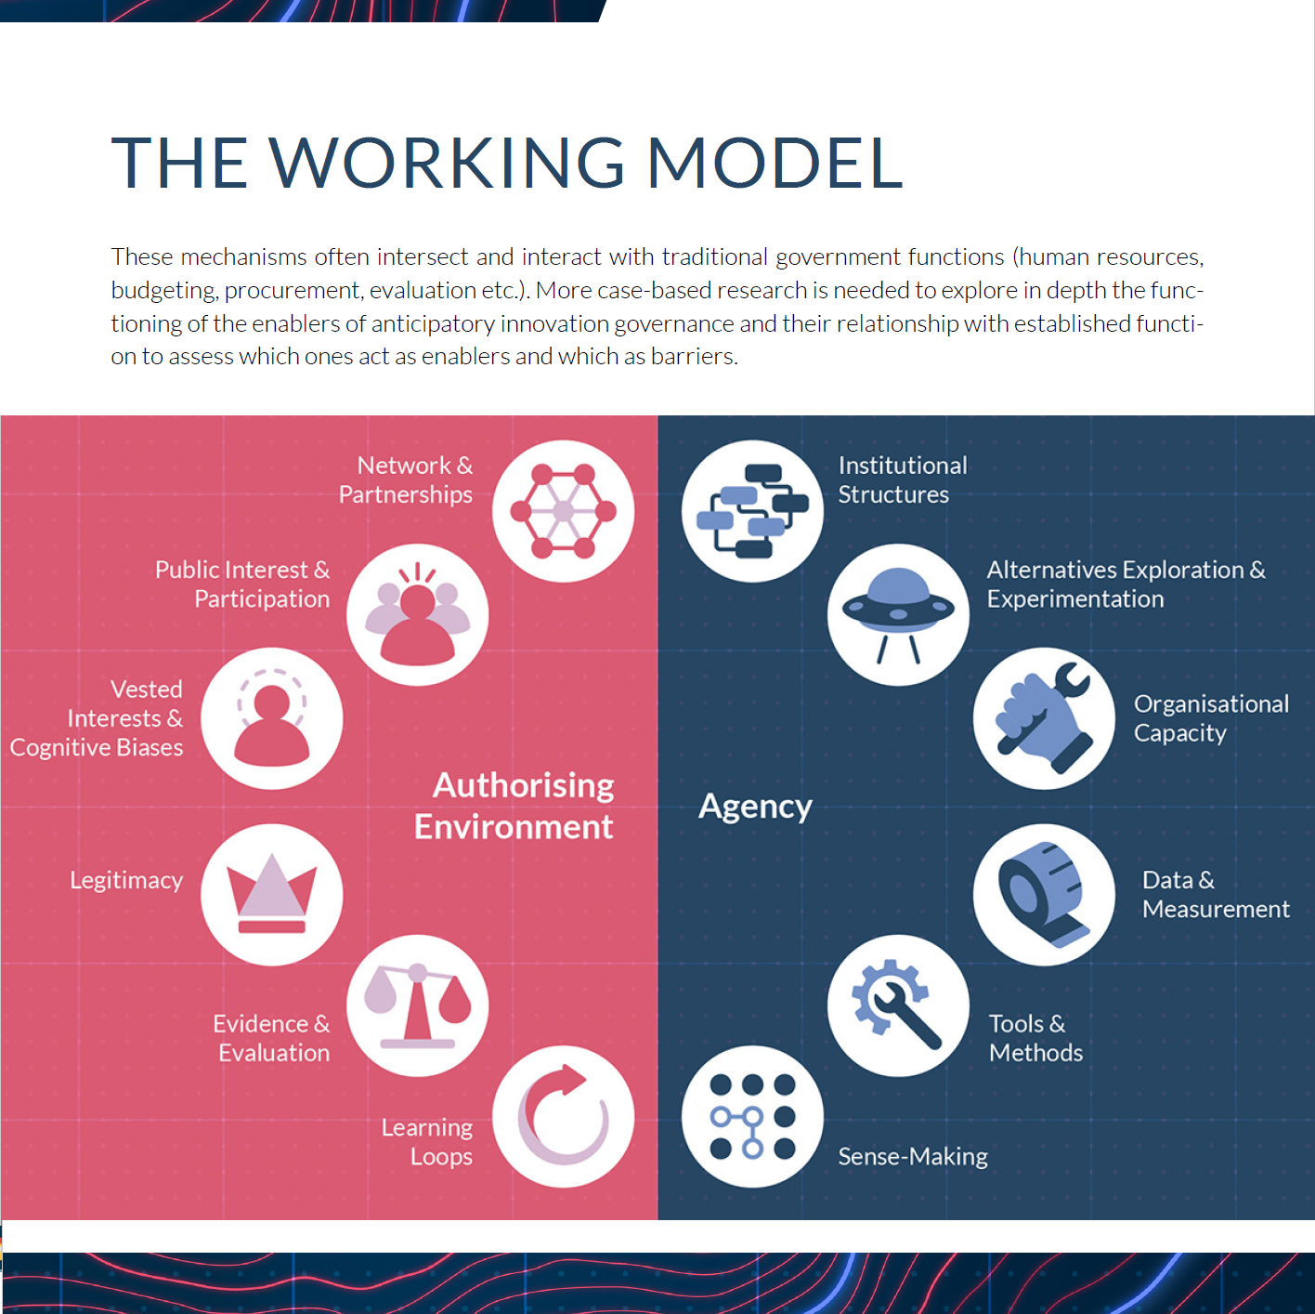
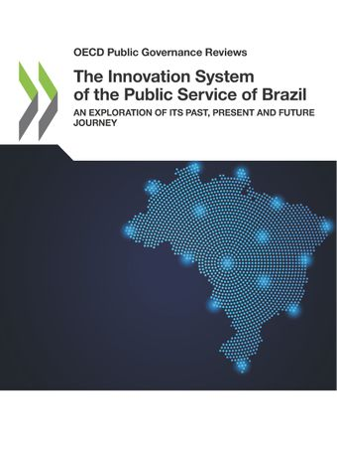
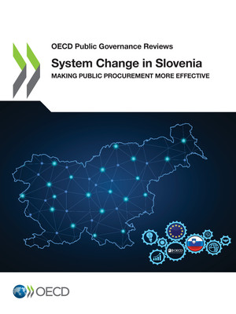
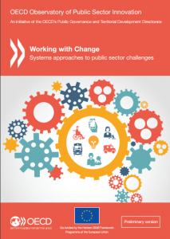
OPSI MISSION
PROVIDING TRUSTED ADVICE
Anticipatory Innovation Governance

Slide 6
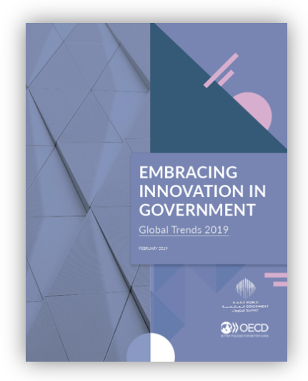
GLOBAL TRENDS 2019

Slide 7
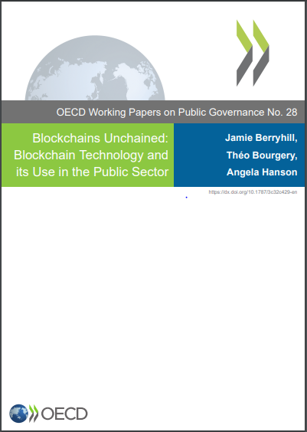
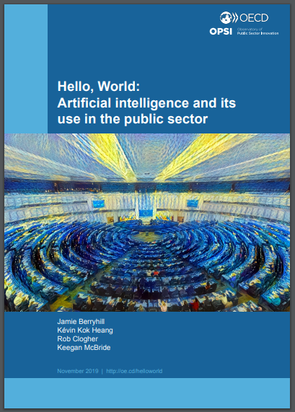
INNOVATION PRIMERS
Cracking the Code is the third in the series of OPSI innovation primers.
DRAFT
Blockchain
Artificial Intelligence
Rules as Code
DIGDIR 2021
#RulesAsCode

Slide 8
#RulesAsCode

Slide 9
JAMES MOHUN
Policy analyst
@jamesmohun
DIGDIR 2021
#RulesAsCode

Slide 10
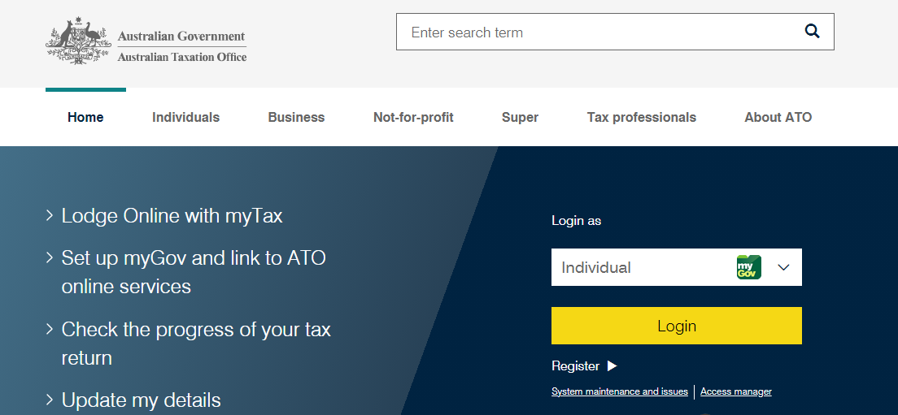
WHAT IS RAC?
Source: Australian Tax Office, 2021
DIGDIR 2021
#RulesAsCode

Slide 11
RAC
01
OUTPUT
A coded version of rules that can be understood and used by a computer
02
APPROACH
A strategic, deliberate and systemic approach to rulemaking involving the creation of a human-readable and machine-consumable version of government rules
03
DIGDIR 2021
#RulesAsCode

Slide 12
NEW CONTEXT
01
GREATER COMPLEXITY, SPEED OF CHANGE
02
NEED FOR BETTER RULES AND RULEMAKING
03
ACCENTUATING PROBLEMS WITH CURRENT RULEMAKING
DIGDIR 2021
#RulesAsCode

Slide 13
CURRENT STATE: RULEMAKING
Translate
Translate
Policy analysts and drafters write legislation (Human readable)
Rules analysts and lawyers translate legislation into rules speak
Software developers translate rules speak into code
Rules to business systems
Source: Digital.Govt.NZ, 2018 (Adapted)
DIGDIR 2021
#RulesAsCode

Slide 14
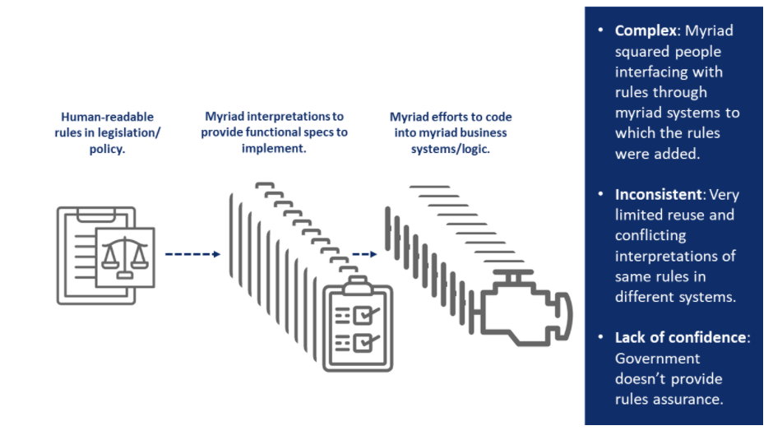
CURRENT STATE: RULEMAKING
Source: Rules as Code Handbook, 2019
DIGDIR 2021
#RulesAsCode

Slide 15
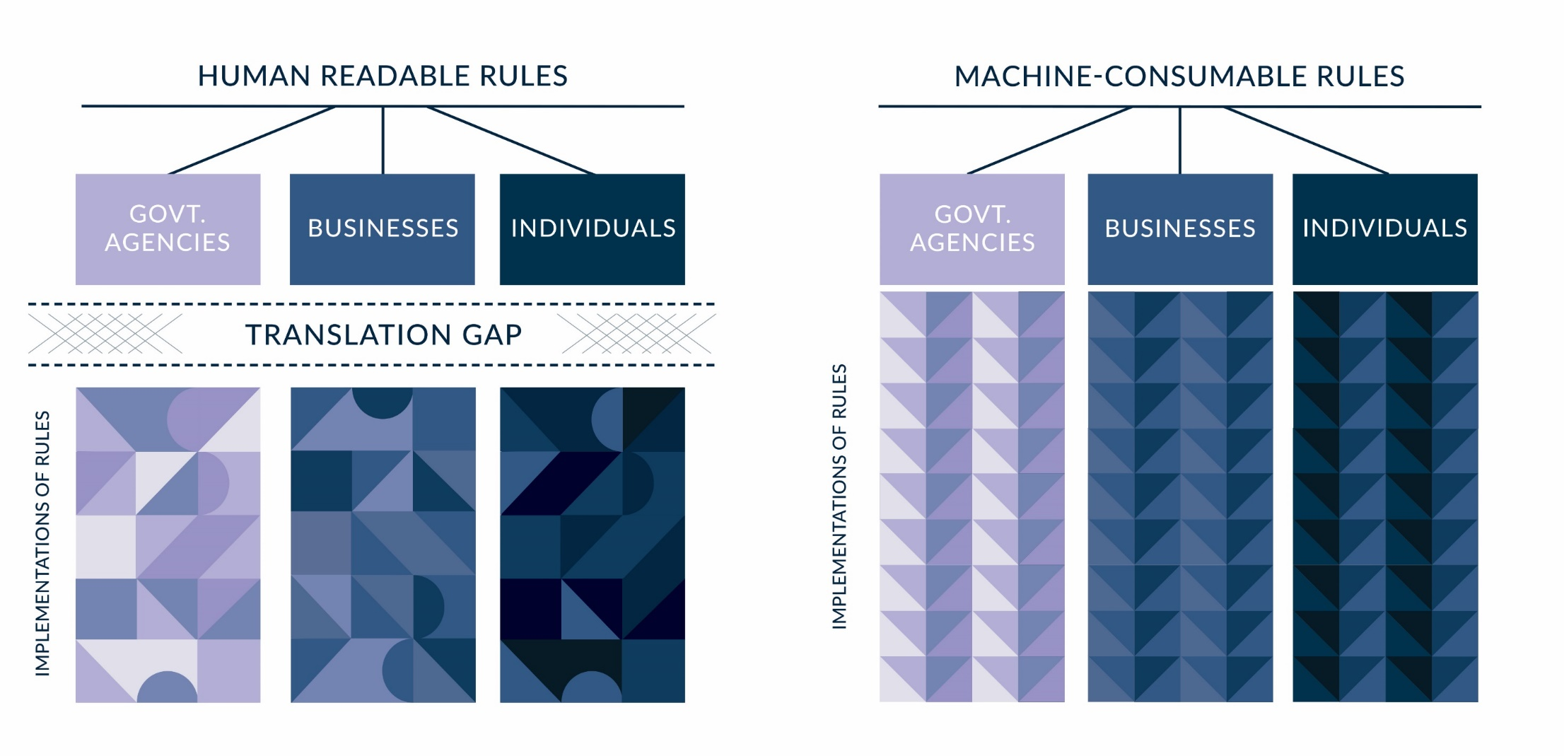
RAC CONCEPT
#RulesAsCode

Slide 16
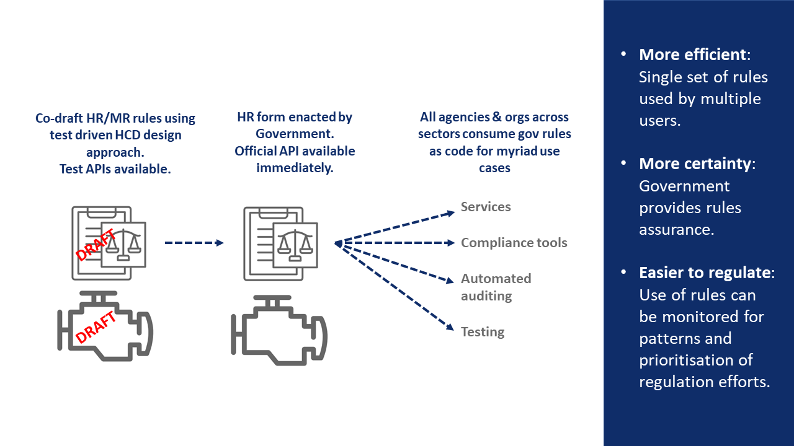
FUTURE STATE: RULES AS CODE
Source: digital.nsw, 2019
DIGDIR 2021
#RulesAsCode

Slide 17
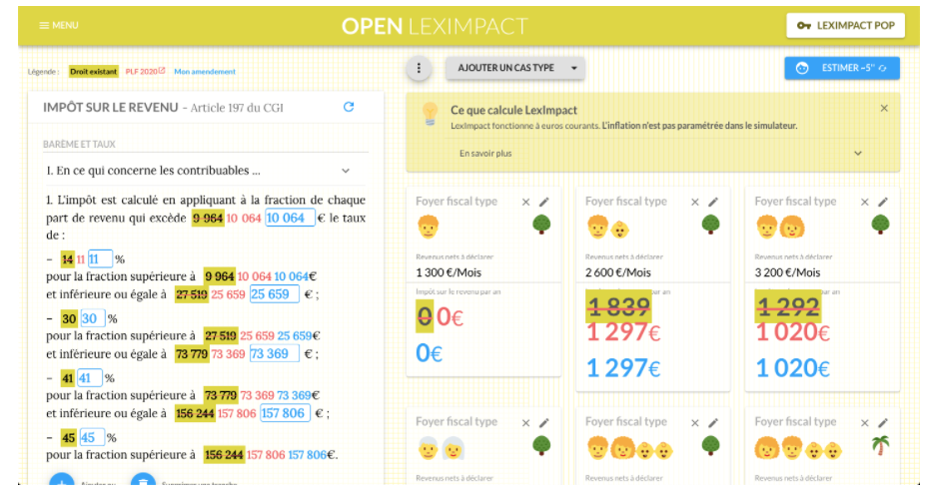
USE CASES
01
02
03
DIGDIR 2021
#RulesAsCode

Slide 18
USE CASES
Customer service minister Victor Dominello on Thursday said rules-as-code was a “game changer for smart regulation” and will make compliance easier for customers.
“Bringing our statute book into the 21st Century through this technology helps to reduce errors, eliminate paper, save money and ultimately give precious time back to customers and industry.”
IT News
01
02
03
DIGDIR 2021
#RulesAsCode
Notes:
Link: https://www.fairtrading.nsw.gov.au/community-gaming/community-gaming-regulation-check
Link to Datalex: http://beta.datalex.org/app/consultation?rulebase=http%3A%2F%2Faustlii.community%2Ffoswiki%2FDataLex%2FCommunityGamingRegKB

Slide 19
BENEFITS AND CONSIDERATIONS
POTENTIAL BENEFITS | POTENTIAL CONSIDERATIONS
Better policy outcomes and enhanced service delivery | New rules or old?
Greater transparency | Technology choice
Disintermediation and agile government | Sharing coded rules
Improved consistency and fairness | Data
De-risking | Scaling solutions
Interoperability and efficiency | Capability
Innovation | Governance and legal implications
 | Choice, not technocratic default
01
02
03
DIGDIR 2021
#RulesAsCode

Slide 20
Slide 06
PRINCIPLES
The adoption of a principles-based approach could help to guide the construction of fair, just and effective systems based on
machine-consumable rules.
Transparency
Traceability
Accountability
Appropriateness &
Appealability
Availability & Interoperability
Security
DIGDIR 2021
#RulesAsCode
Notes:
Icons made by Kiranshastry, Freepik, Dave Gandy, Pixel perfect on www.flaticon.com.

Slide 21
Slide 07
YOUR QUESTIONS
DIGDIR 2021
#RulesAsCode

Slide 22
Slide 09
READ THE PRIMER
https://oecd-opsi.org/projects/rulesascode/
JOIN THE COMMUNITY
Email opsi@oecd.org
oe.cd/opsi
@OPSIgov
opsi@oecd.org

